Slide 1
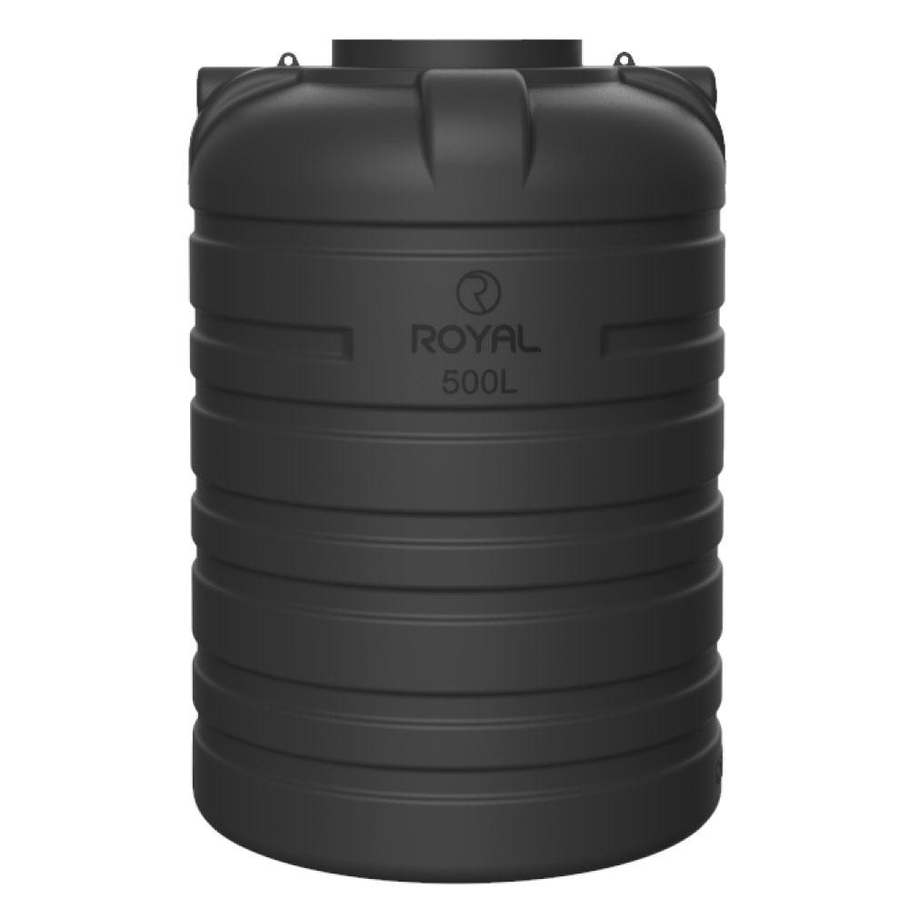
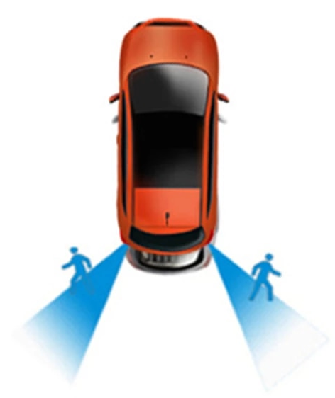
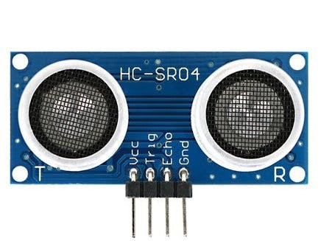
Arduino Session Six
Water Tank Level – Car Parking Assistance, ultrasonic sensor

Slide 2
Home Security System
Stop alarm based on input Password
Use LCD display Screen to display the inputted password
Use PIR sensor to detect any warm body movement, and then raise Alarm

Slide 3
Water Tank Meter Class Work
Car Parking Assistant
Home Work
Use Ultrasonic Sensor to determine height of empty tank
Print percentage of remaining water
Close tank filling valve if level is too high, and display filling state (the valve is controlled using servo motor)
Use Ultrasonic Sensor to determine distance from sensor to object
Display the value of lowest distance
Alarm the user if car is too near to an object

Slide 4
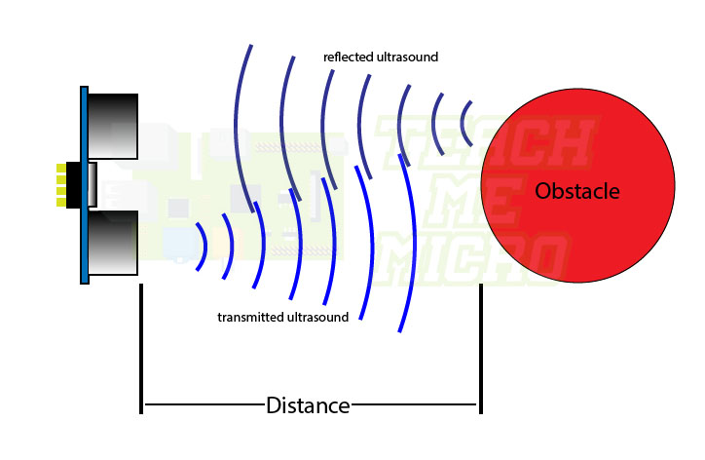
How Ultrasonic works

Slide 5
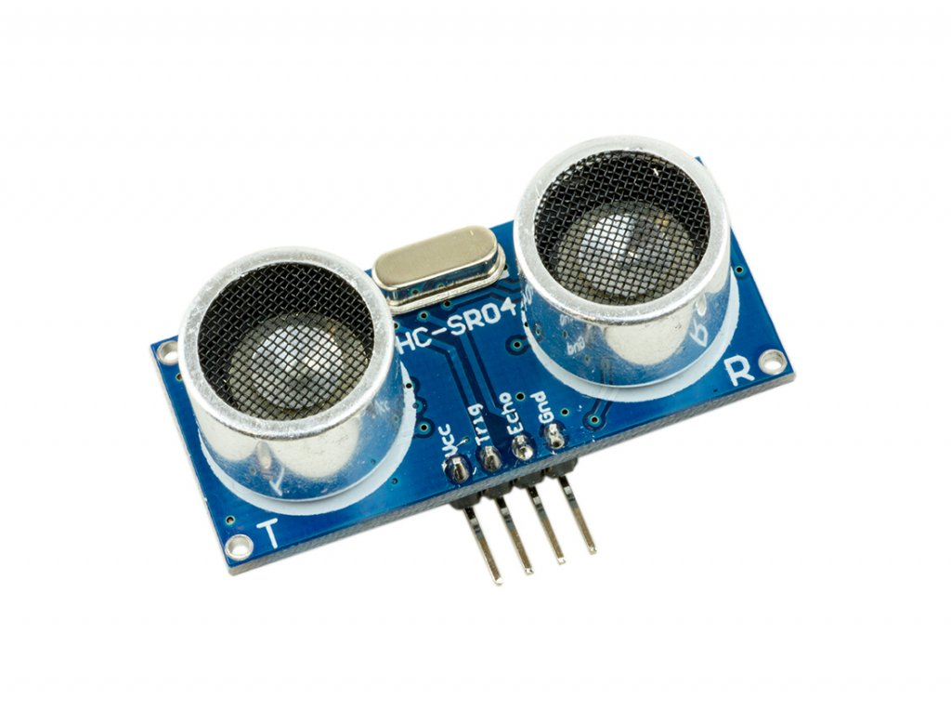
How HC-SR04 Ultrasonic module works

Slide 6
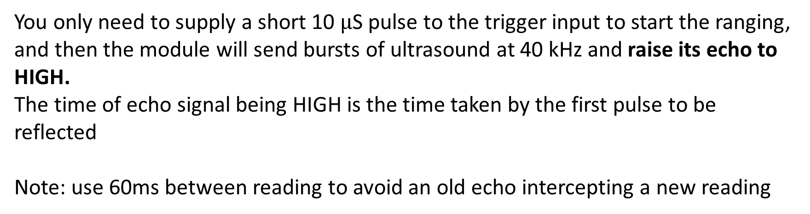
How HC-SR04 Ultrasonic module works
You only need to supply a short 10 $μ$S pulse to the trigger input to start the ranging, and then the module will send bursts of ultrasound at 40 kHz and raise its echo to HIGH.
The time of echo signal being HIGH is the time taken by the first pulse to be reflected
Note: use 60ms between reading to avoid an old echo intercepting a new reading

Slide 7
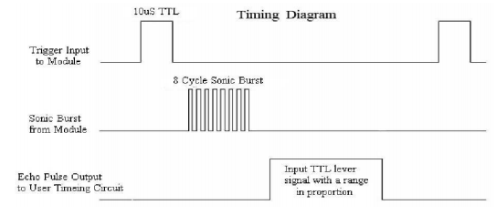
How HC-SR04 Ultrasonic module works

Slide 8
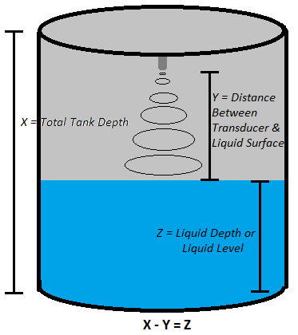
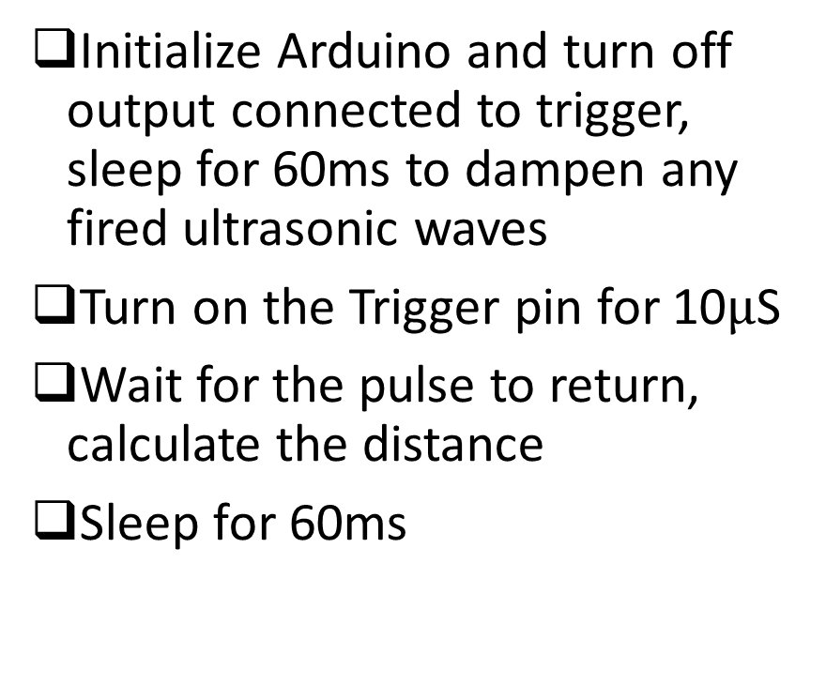
Water Tank Meter
Initialize Arduino and turn off output connected to trigger, sleep for 60ms to dampen any fired ultrasonic waves
Turn on the Trigger pin for 10$μ$S
Wait for the pulse to return, calculate the distance
Sleep for 60ms

Slide 9
Water Tank Meter
Search online on how to use the ultrasonic sensor, and share with us what you find
Estimated time: 10-20mins

Slide 10
Interface LCD module
Search online on how to use the LCD module
Or open tinkercad.com LCD example code from “all circuits”
The LCD should only display the current state of sting
(you might make it blink in case of alarm)
ONLY use the LCD library

Slide 11
Power Backup Lighting
Get any DC adapter and connect it to Arduino as indication of mains voltage presence
Connect battery to Arduino through voltage divider to measure voltage
Connect normal 12v Lead-Acid battery to LED lamp through relay
Connect relay to Arduino to control LED
Connect PIR sensor to Arduino
If PIR sensor is active, and battery is full, light the LED

Slide 12
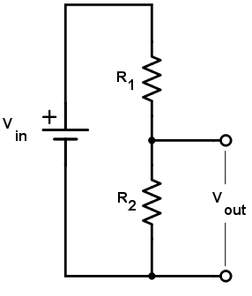
How voltage divider works
This is the basic circuit to be used, the values of each resistor can be obtained from online calculator

Slide 13
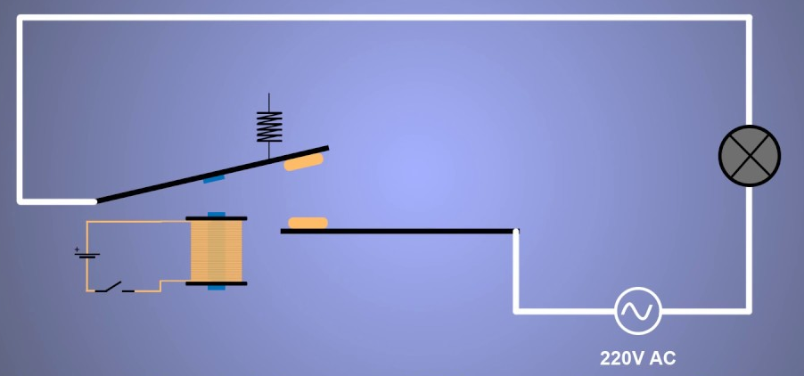
How Relay Works

Slide 14
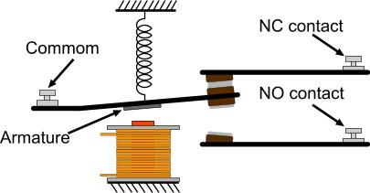
How Relay Works

Slide 15
Kitchen safety system
Connect gas sensor to detect methane gas
Connect Temperature sensor to detect fire
If detected,
open a window using servo motor
Activate a fan using relay
Raise alarm using piezo

Slide 16
Kitchen safety system
Open tinkercad.com

